Slide 1
Lucene and LSI
Natural Language Processing and Information Retrieval
Maeva Lecavelier / 마에바 르꺄블리에 – 50191580

Slide 2
Summary
Indexing with Lucene
Queries with Lucene
LSI: pros and cons
Conclusion

Slide 3
Lucene
Indexing with Lucene

Slide 4
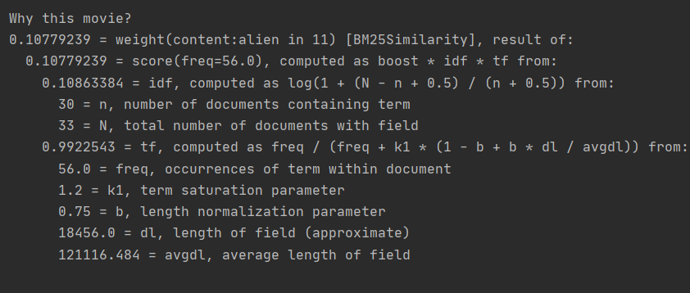

Lucene
Indexing with Lucene
How does Lucene work?
How to execute my code?
Word Break rules from the Unicode Text Segmentation algorithm: http://unicode.org/reports/tr29/
TF-IDF
I used an IDE: IntelliJ. I added three Lucene libraries: lucene-core-8.5.1.jar, lucene-analyzers-common-8.5.1.jar, lucene-queryparser-8.5.1.jar.
Using an IDE is easier. Or you should update CLASSPATH with the libraires. Then, you can run java file with option:
First option can be ‘-v’ for activate verbose to have explanation about score.
Or, first option can be anything else for activating indexing
Or you can use both option (‘-v’ and anything else) to activate verbose and indexing.
If there is not parameter it will just request for a query and then do the search normally.

Slide 5
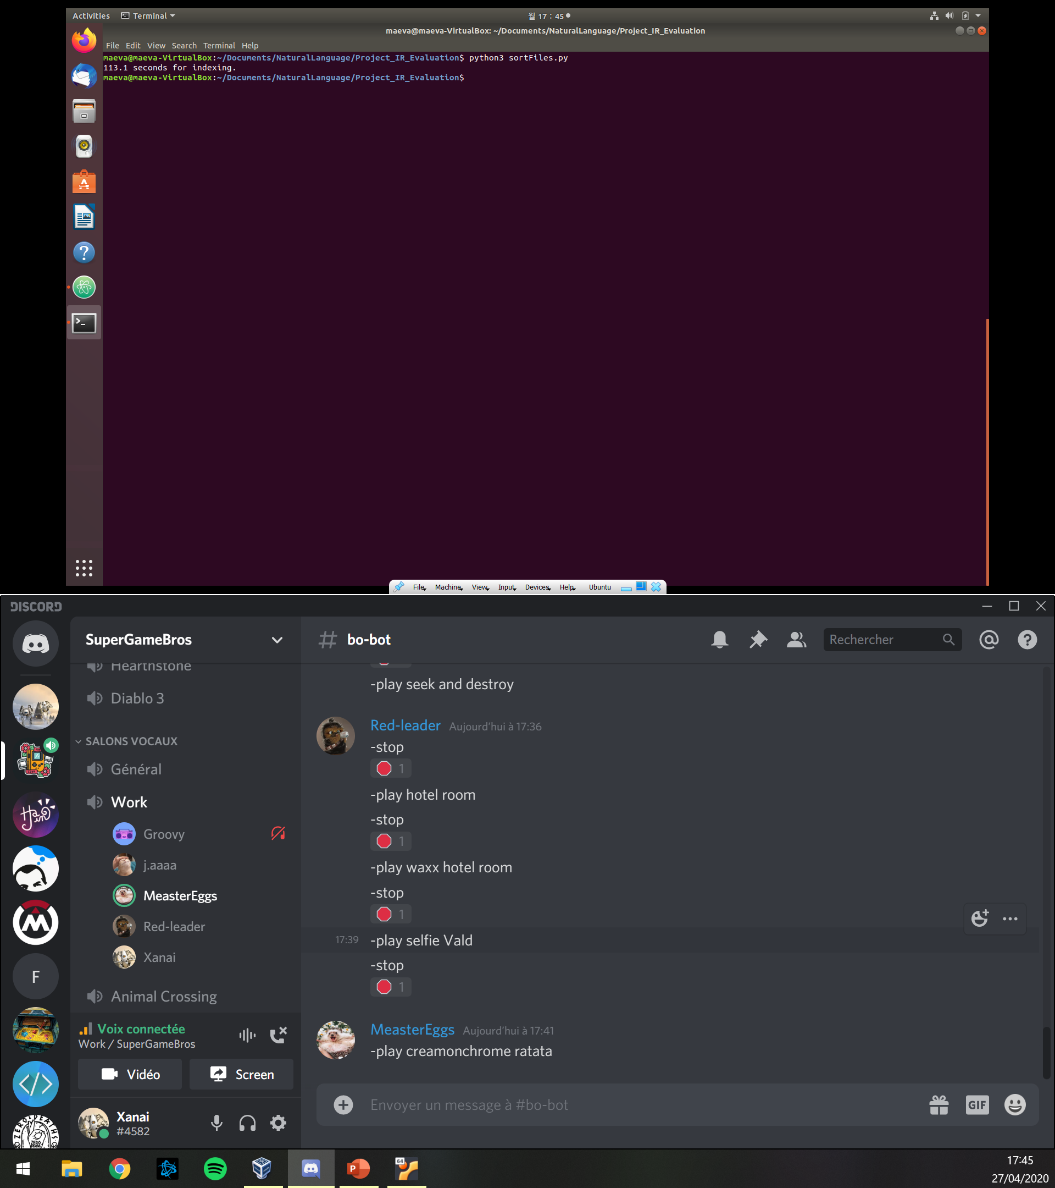
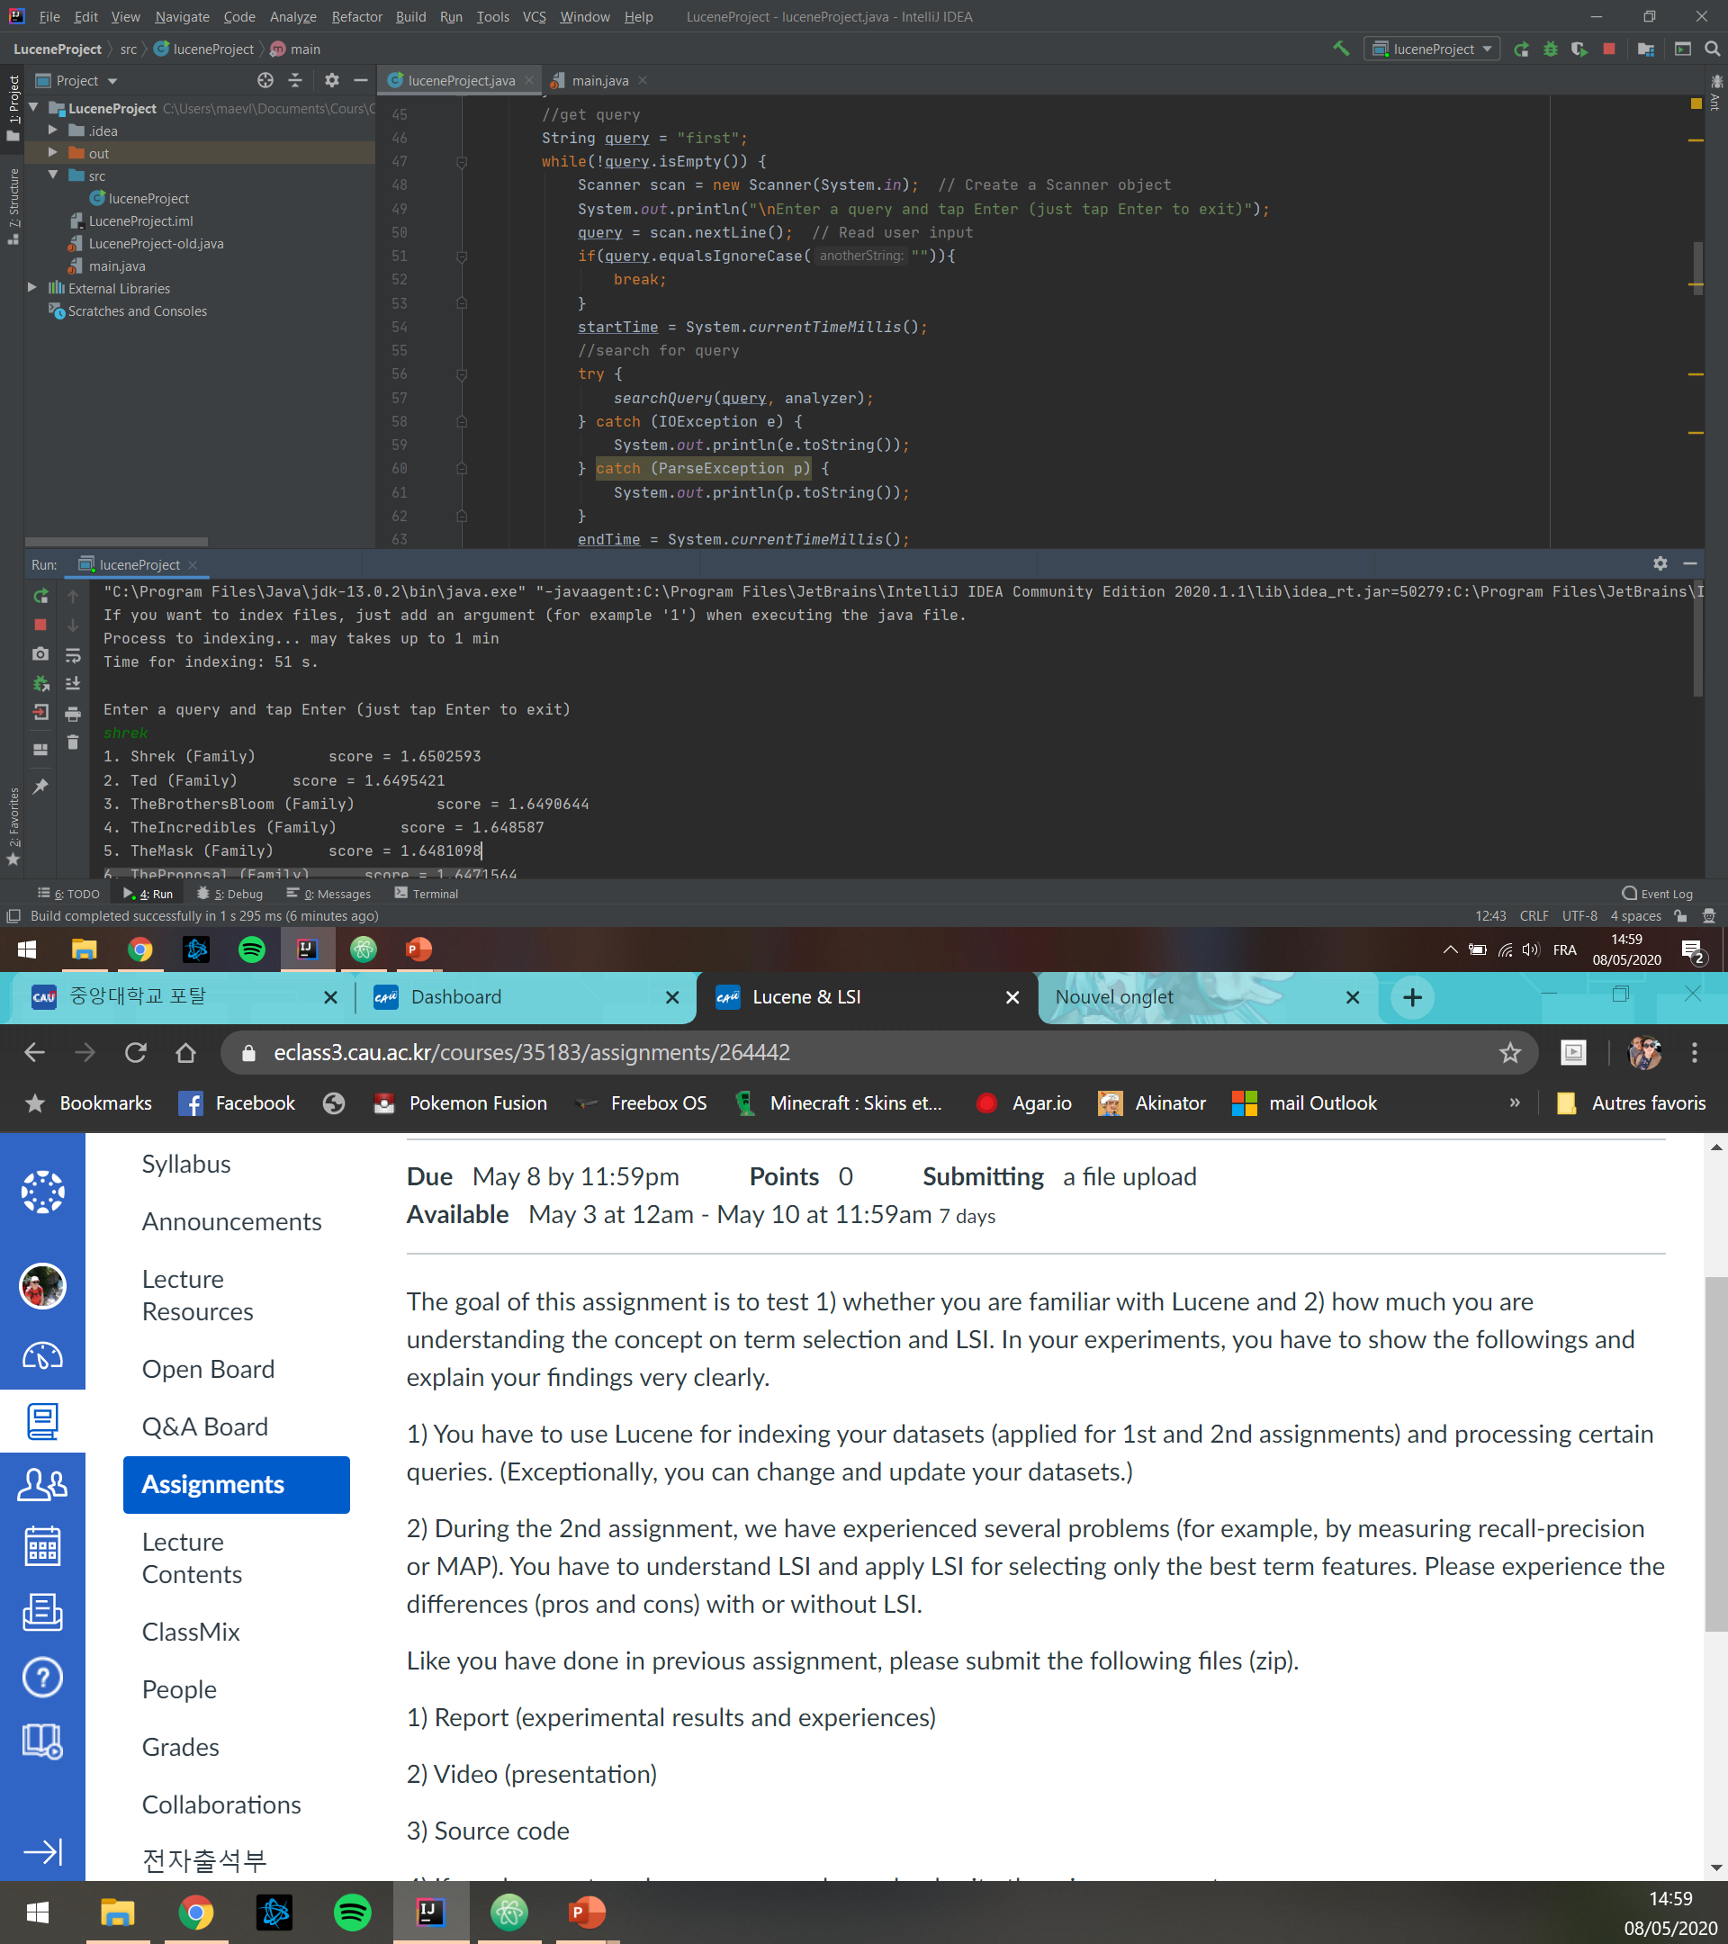
Lucene
Indexing with Lucene
Performance
Assignment 2 (with python)
With Lucene:

Slide 6
Lucene
Queries with Lucene

Slide 7

Lucene
Queries with Lucene
Queries example
Expected results
Donkey
Dead
May the force be with you
Mars VS planet Mars
Shrek
Horror movies
Star Wars 2
The martian and Watchmen

Slide 8
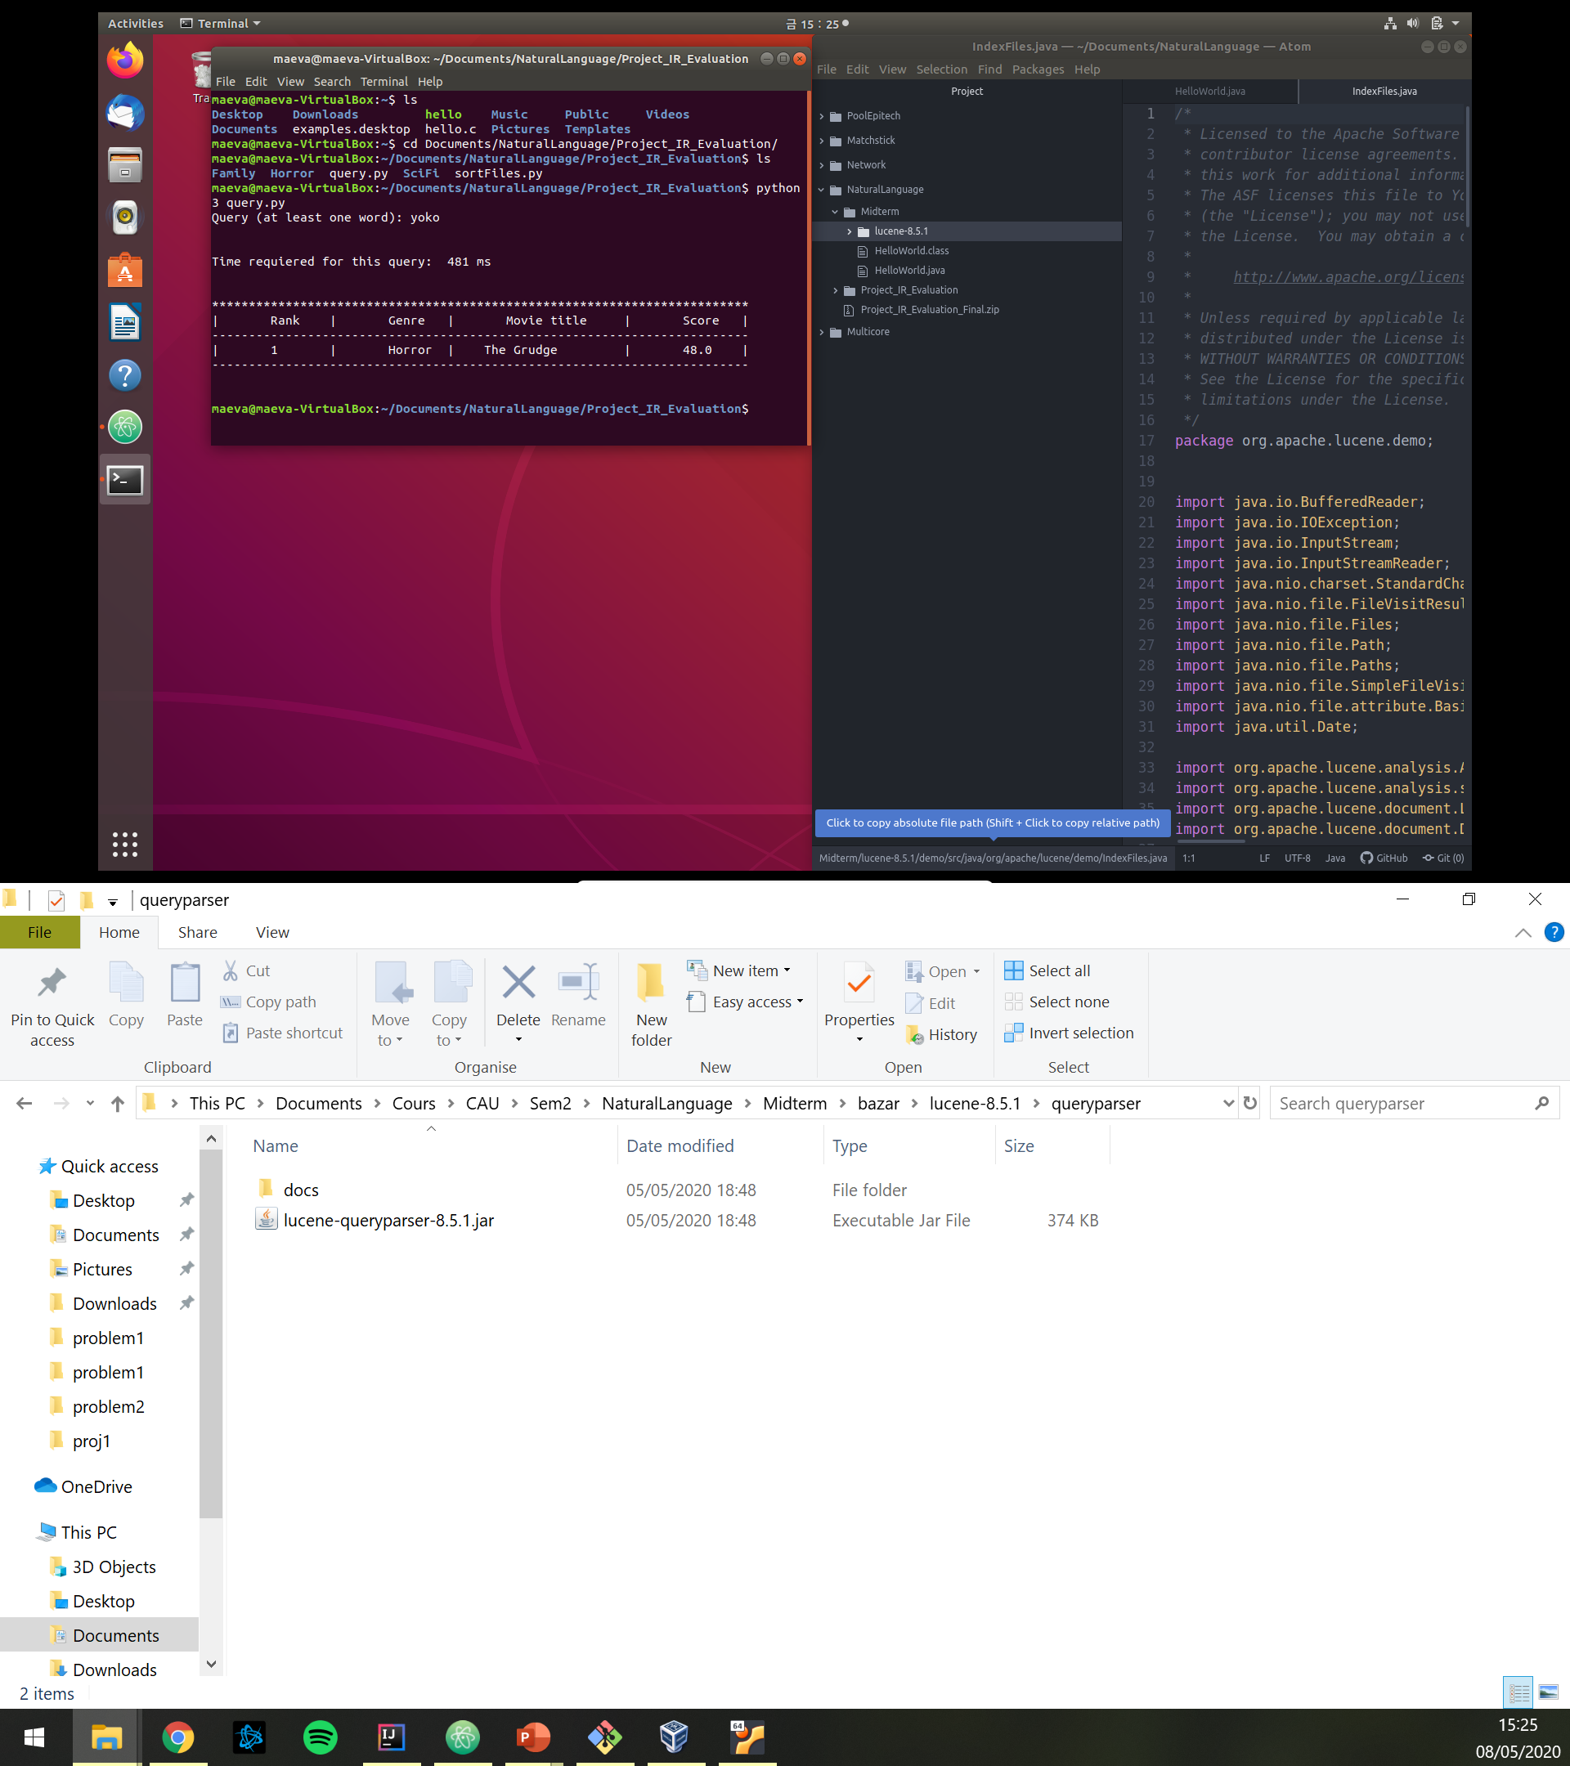
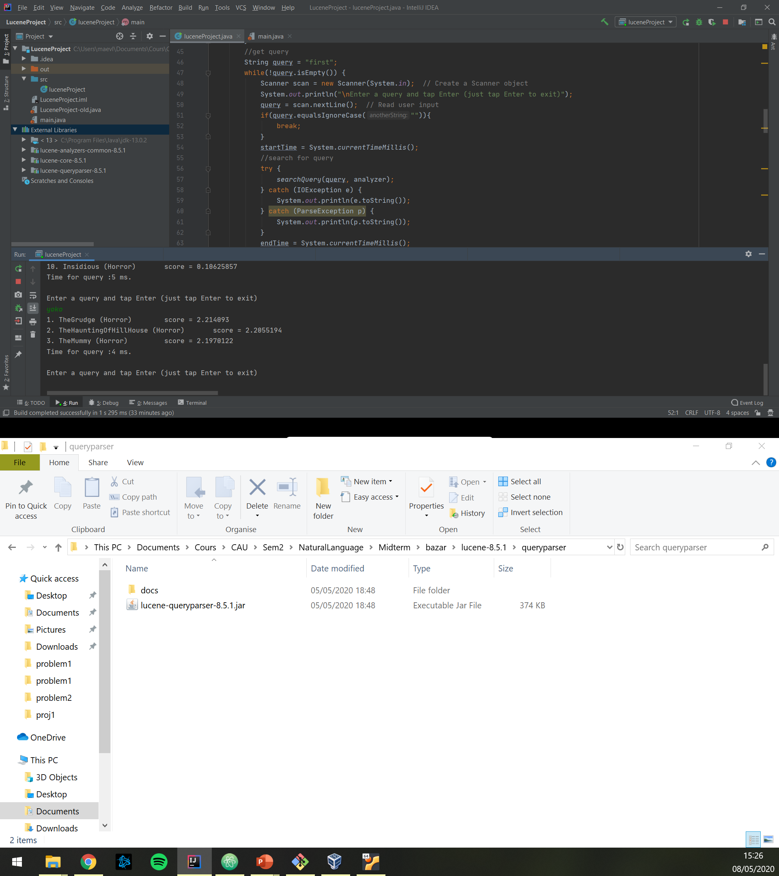
Lucene
Queries with Lucene
Performance
Assignment 2 (with python)
With Lucene

Slide 9
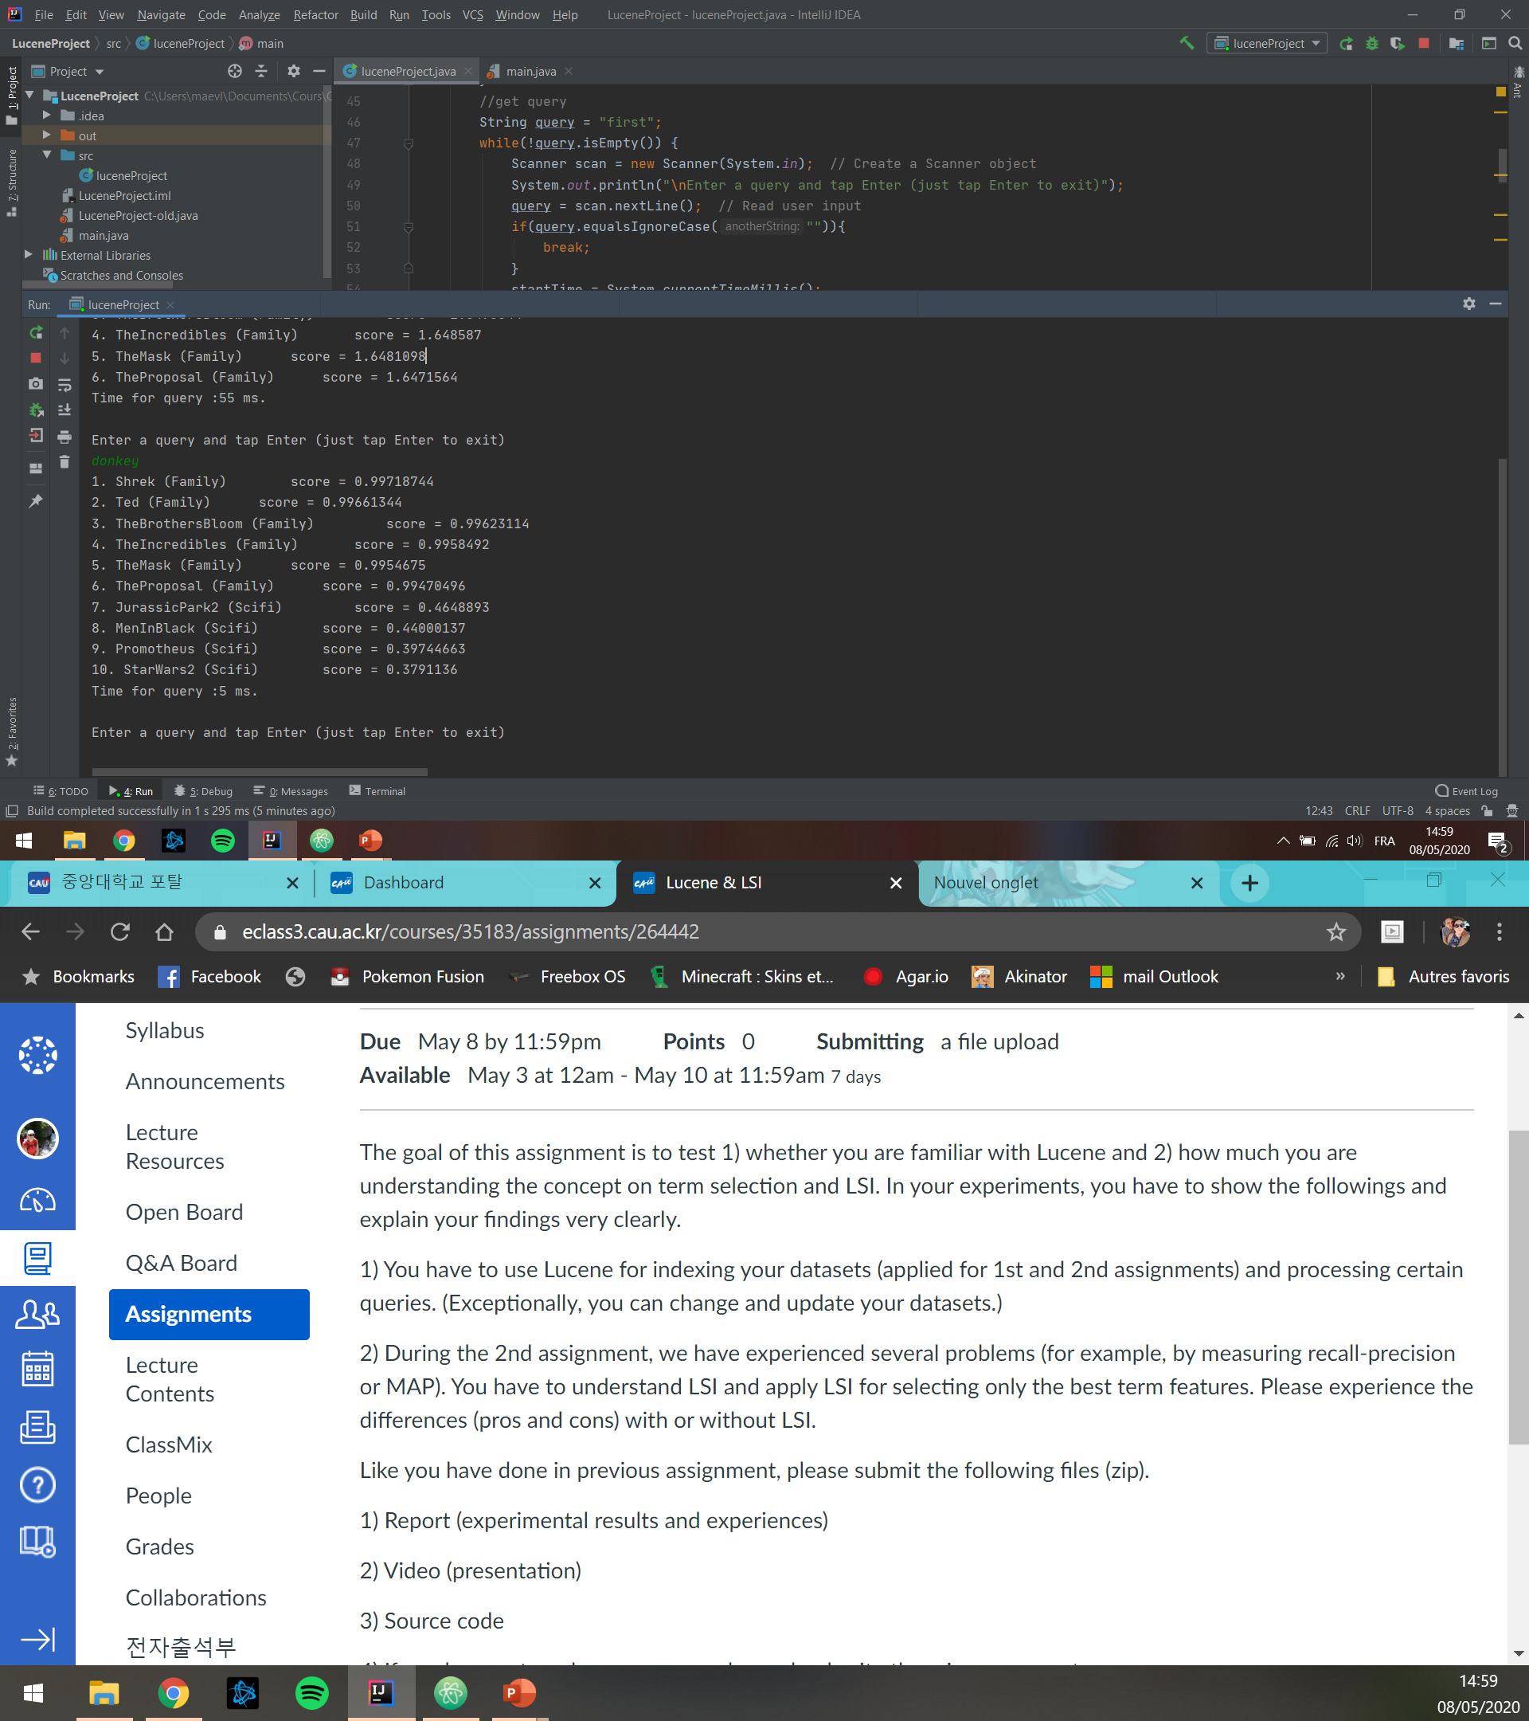
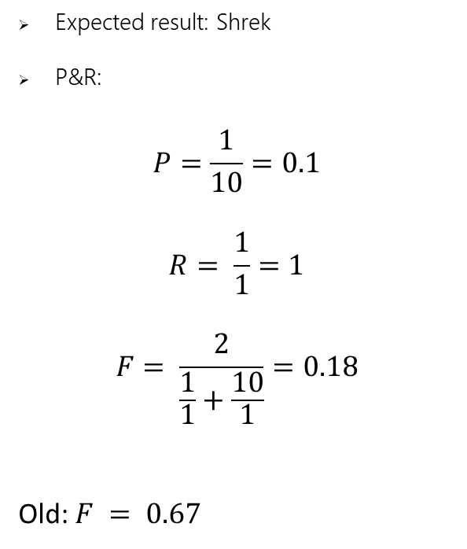
Lucene
Queries with Lucene
« donkey »
Expected result: Shrek
P&R:
$$P=\frac{1}{10}=0.1$$
$$R= \frac{1}{1}=1$$
$$F= \frac{2}{\frac{1}{1}+\frac{10}{1}}=0.18$$
Old: $F = 0.67$

Slide 10
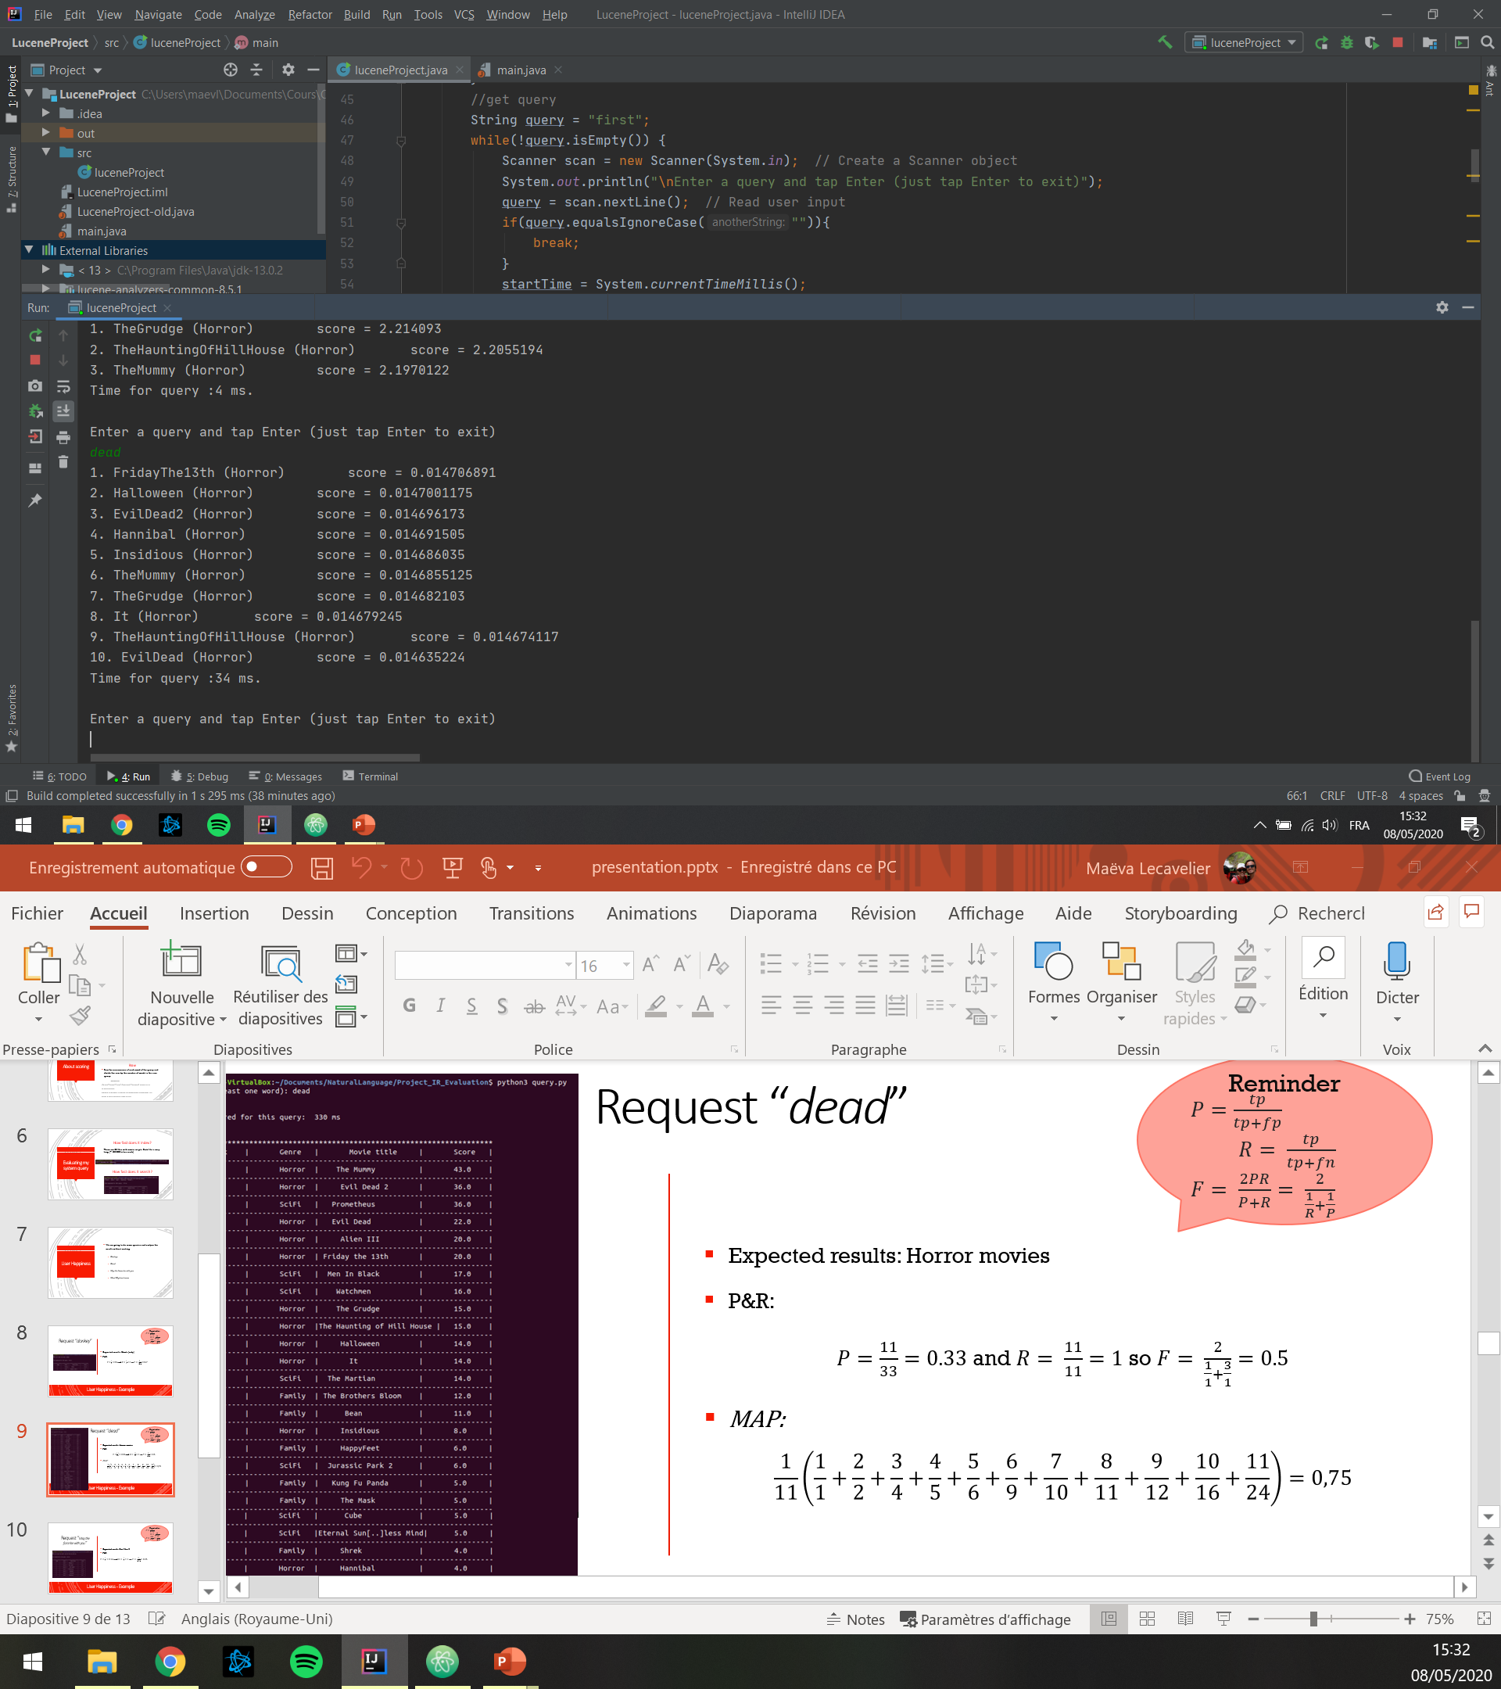
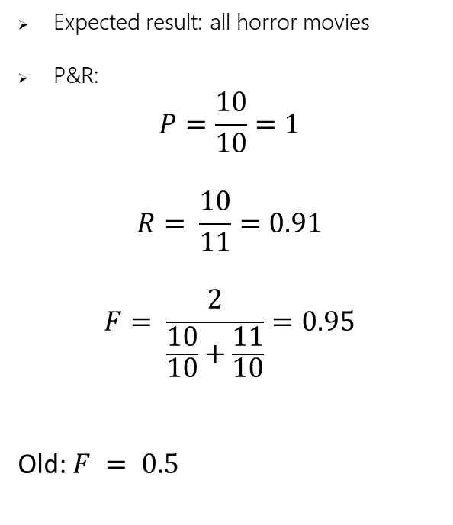
Lucene
Queries with Lucene
« dead »
Expected result: all horror movies
P&R:
$$P=\frac{10}{10}=1$$
$$R= \frac{10}{11}=0.91$$
$$F= \frac{2}{\frac{10}{10}+\frac{11}{10}}=0.95$$
Old: $F = 0.5$

Slide 11
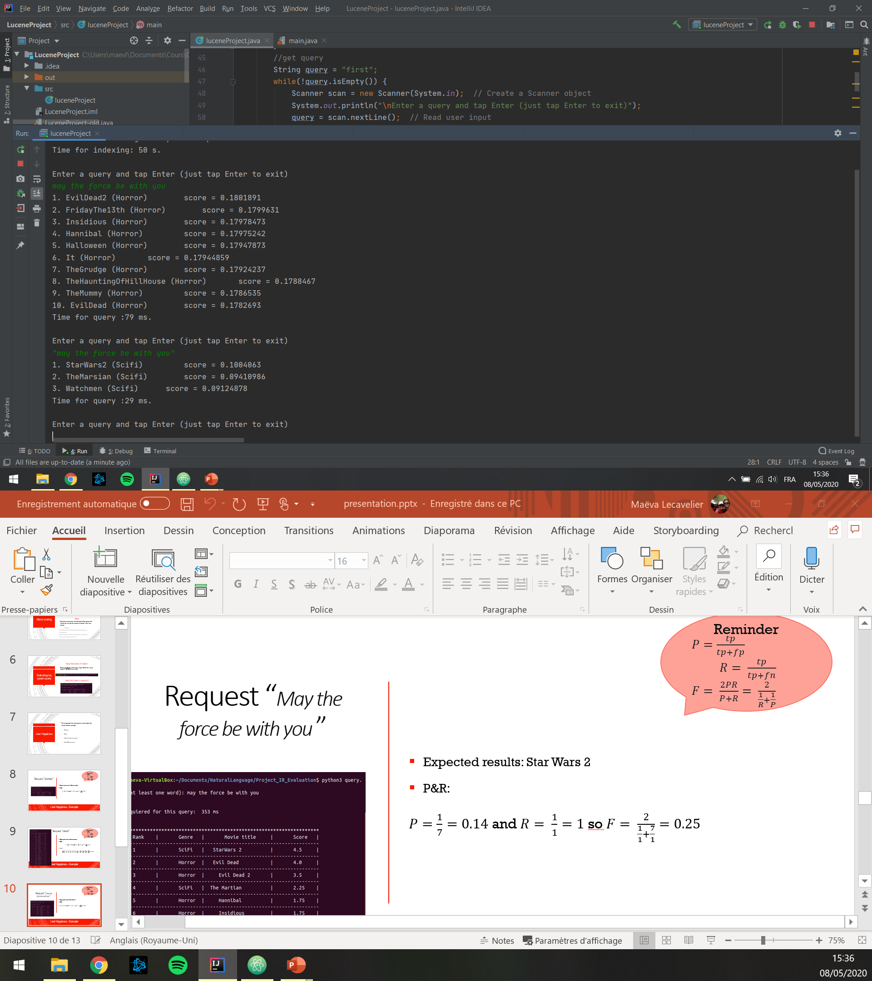
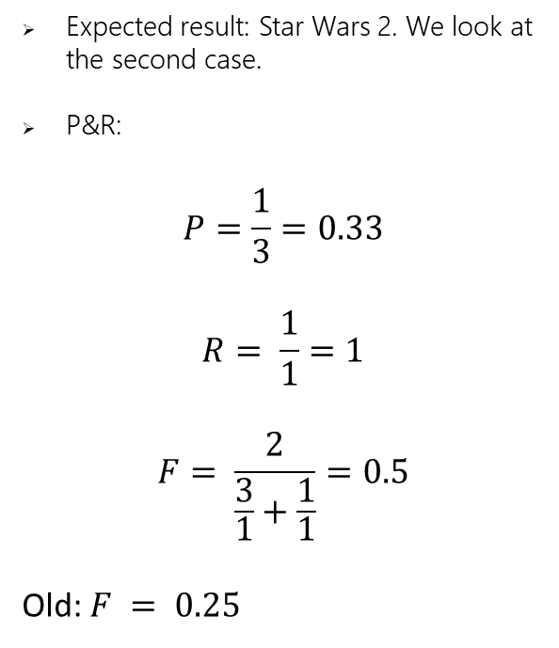
Lucene
Queries with Lucene
«may the force be with you »
Expected result: Star Wars 2. We look at the second case.
P&R:
$$P=\frac{1}{3}=0.33$$
$$R= \frac{1}{1}=1$$
$$F= \frac{2}{\frac{3}{1}+\frac{1}{1}}=0.5$$
Old: $F = 0.25$

Slide 12
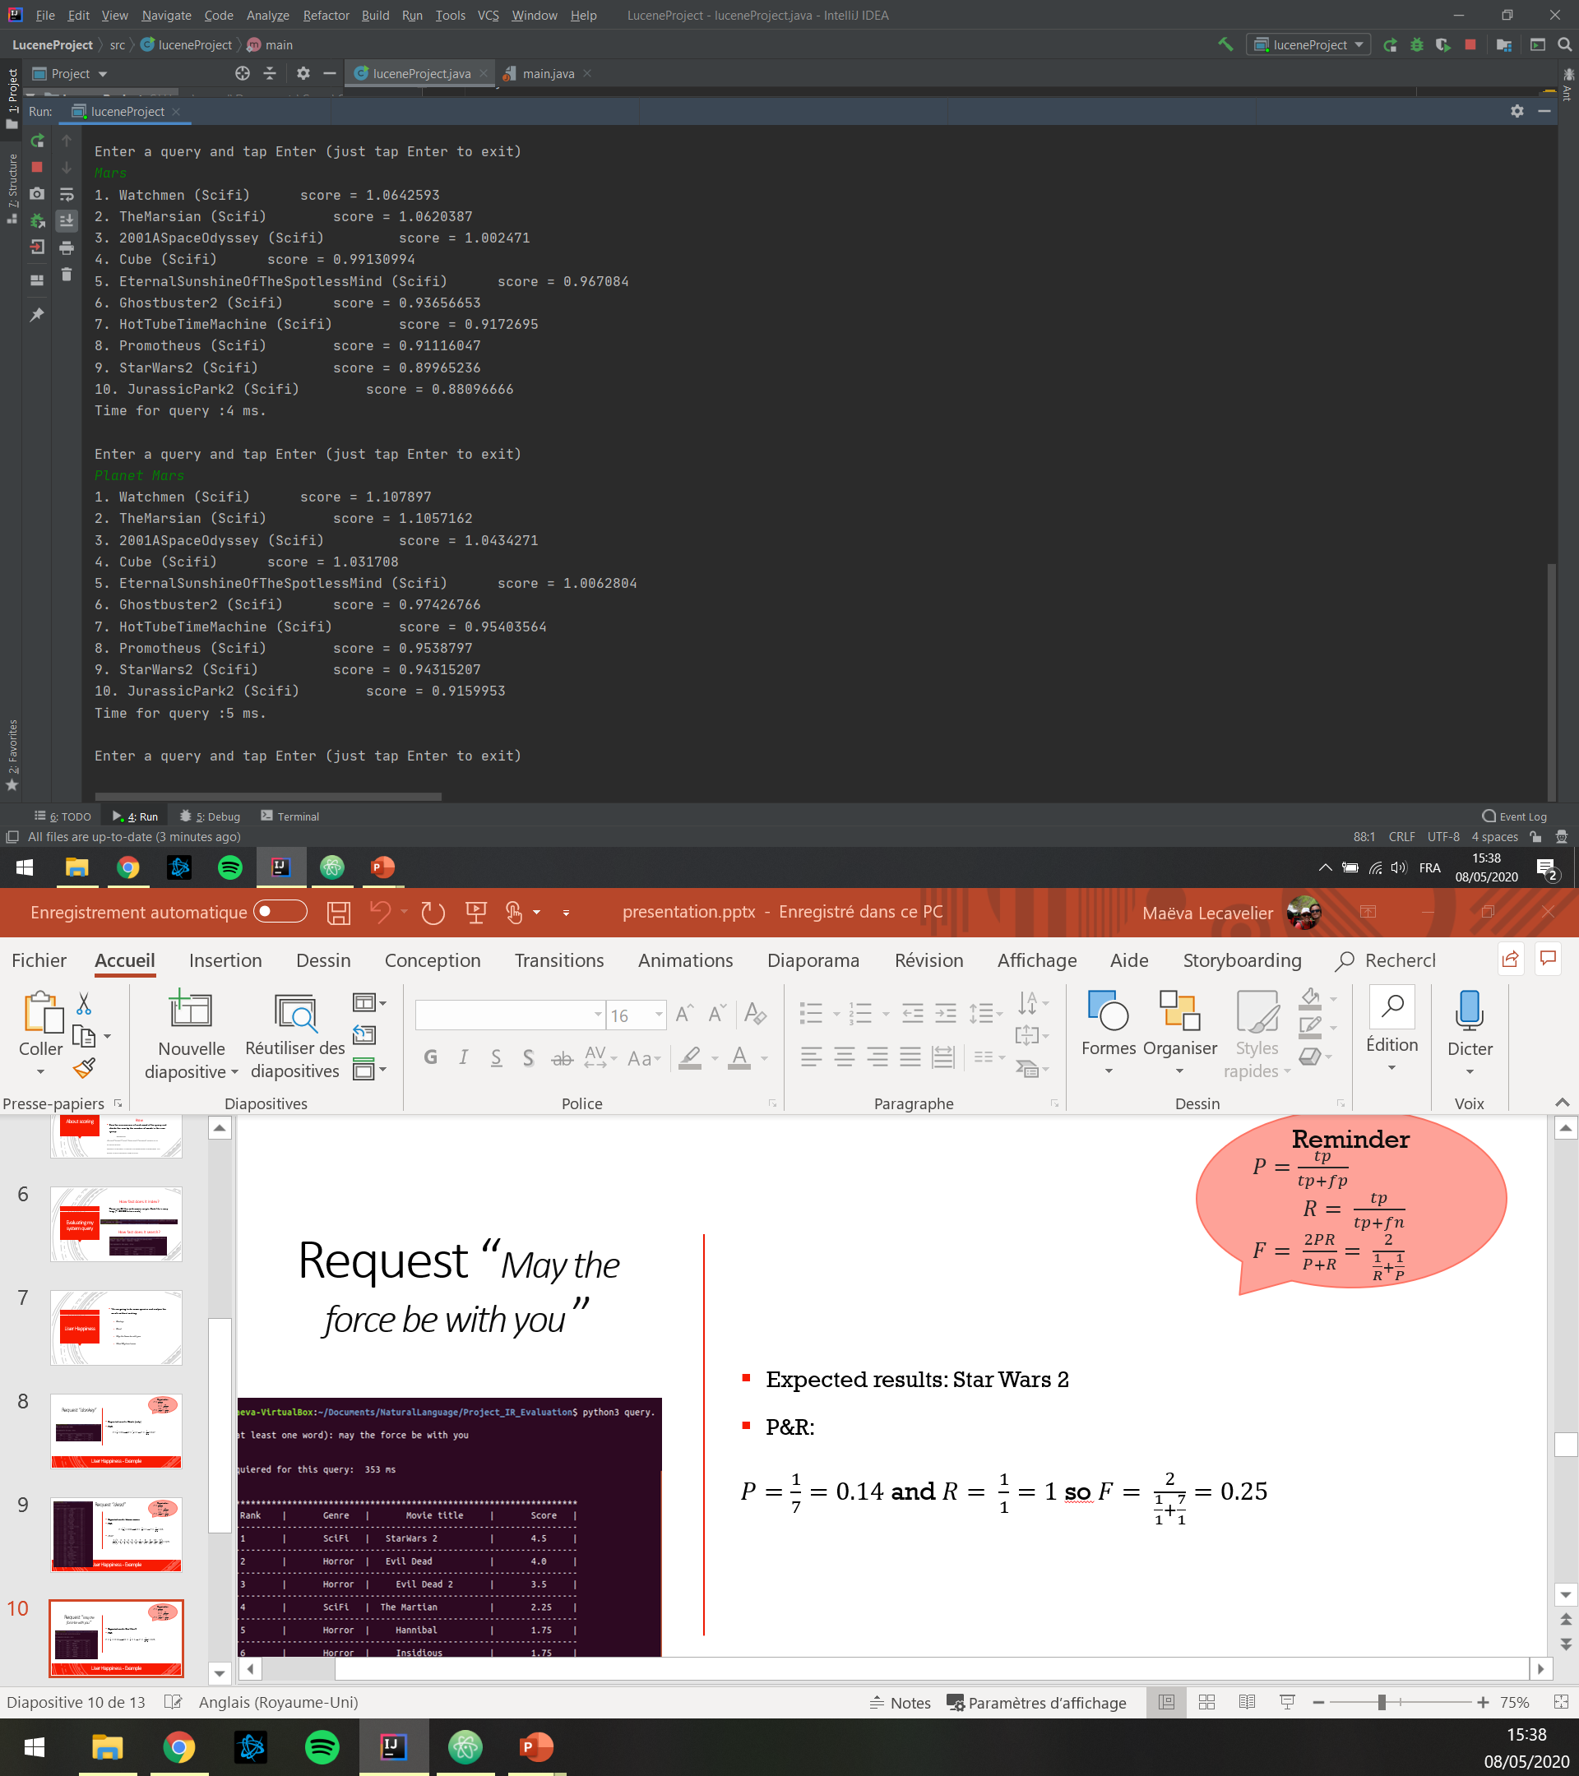
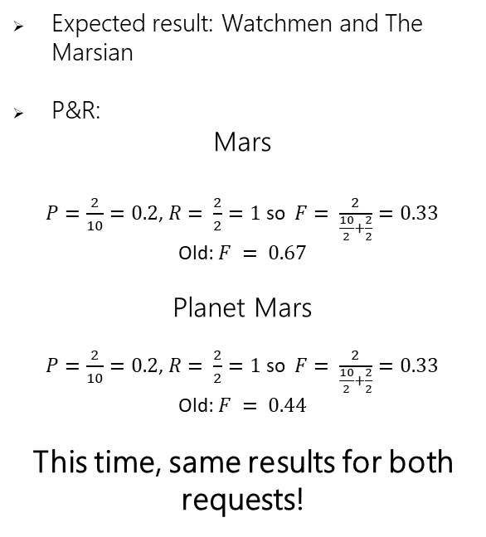
Lucene
Queries with Lucene
« Mars » VS « Planet Mars »
Expected result: Watchmen and The Marsian
P&R:
Mars
$P=\frac{2}{10}=0.2$, $R= \frac{2}{2}=1$ so $F= \frac{2}{\frac{10}{2}+\frac{2}{2}}=0.33$
Old: $F = 0.67$
Planet Mars
$P=\frac{2}{10}=0.2$, $R= \frac{2}{2}=1$ so $F= \frac{2}{\frac{10}{2}+\frac{2}{2}}=0.33$
Old: $F = 0.44$
This time, same results for both requests!

Slide 13
LSI
What is it? How does it work?

Slide 14
LSI
What is it? How does it work?
What is it?
Pros and cons
Pros
Increases recall
Independent from words
Cons
Costly
Choosing accurate number of dimensions
Indexing and IR method that uses SVD.
Identify patterns between terms and concepts
Query about concepts not only words

Slide 15
Conclusion
Difficulties and conclusion
Difficulties
Conclusion
Using a new library in 5 days.
Some docs were old and unusable.
Understand principles and how it works.
Exploiting results
Lucene is very powerful.
LSI seems to be the best alternative for query system.
But it’s heavy to include this in a system for beginners.

Slide 16
Conclusion
Sources
Sources
https://www.tutorialspoint.com/lucene/lucene_adddocument.htm
https://stackoverflow.com/questions/5694385/getting-the-filenames-of-all-files-in-a-folder
https://docs.oracle.com/javase/8/docs/api/java/nio/file/Files.html
https://www.w3schools.com/java/java_user_input.asp
https://examples.javacodegeeks.com/core-java/apache/lucene/lucene-query-parser-example/
https://en.wikipedia.org/wiki/Latent_semantic_analysis
And mostly lucene docs included in the zip files

Slide 17
Conclusion
Thank you
Thank you !

